Slide 1
FCC3 246: CONCRETE MATERIALS
Lecture 9: FORMWORK & FALSEWORK
Department of Civil & Construction Engineering
University of Nairobi
mwauras@uonbi.ac.ke

Slide 2
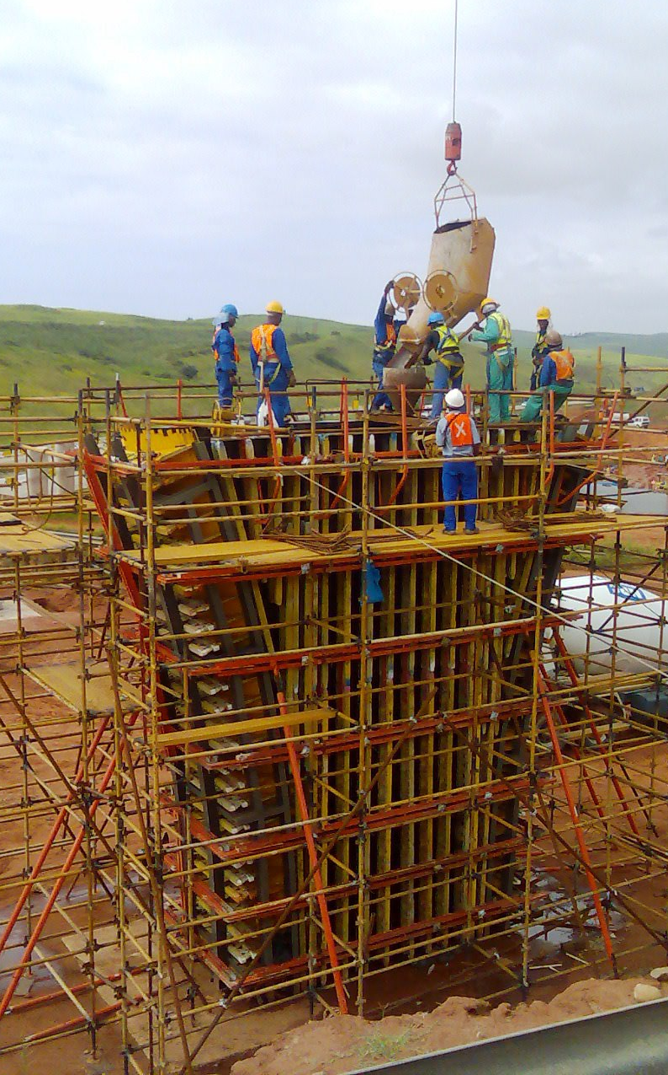
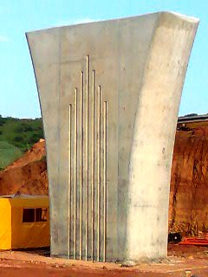
Formwork & Falsework

Slide 3
What is Formwork?
Concrete when mixed first is wet and in afluid plastic form
For it to form any concrete member, the wet concrete must be placed in a suitable mould to retain the shape, size and position of the desired member as the concrete sets
These moulds or forms are usually referred to as formwork
It is important to appreciate that the actual formwork is the reverse shape of the concrete member which is to be cast
Formwork is best described as “ A structure which is usually temporary but can be whole or part permanent, used to contain poured concrete to mould it into required dimensions and support it until it is able to support itself”

Slide 4
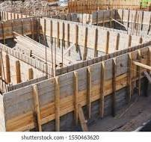
Purpose of Formwork
Temporary structure that moulds the concrete to shape and imparts the surface finish
Supports the concrete until it has gained sufficient strength to be self-supporting without deformation or excessive deflection
Ensure accurate position and levels.

Slide 5
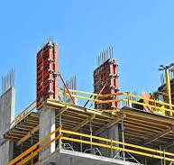
Types of Formwork
Foundation Formwork
Column Formwork
Slab Formwork
Beam Formwork
Wall Formwork

Slide 6
Parts of Formwork
Formwork Sides - Limits width and shape of wet concrete and has to resist the hydrostatic pressure of the wet concrete which will diminish to zero within a matter of hours depending on setting and curing rate
Grout tight joints - Formwork must have sufficiently tight joints to prevent loss of fine material from concrete referred to as grout
Formwork base or soffit - Limits depth and shape of wet concrete and has to resist the initial dead load of the wet concrete and later the dead load of the dry set concrete until it has gained sufficient strength to support its own dead weight which is usually several days after casting depending on curing rate. Here, formwork is a temporary mould into which wet concrete and reinforcement is placed to form a particular desired shape with a pre-determined strength.
Inside the formwork is wet concrete once placed whose density is greater than that of the resultant set and dry concrete.

Slide 7
General Requirements for Formwork
It should be sufficiently rigid to prevent undue movement during the placing of the wet concrete
It should be of sufficient strength to withstand working loads and weight of wet concrete

Slide 8
General Requirements for Formwork
It must have sufficiently tight joints to prevent loss of fine material of sand, cement and water (grout) from concrete especially during compaction (vibration) of concrete
Erection and stripping shall be easily performed with units of manageable sizes

Slide 9
General Requirements for Formwork
The general designs of formwork are strong, stable and leak-proof
The use of telescopic units, adjustable props and special beam and column clamps, permit the easy erection and dismantling of formwork
Thus, formwork is usually made of braced panels of timber (wood), metal or plastic.

Slide 10
Requirements of Formwork
Checks before concreting:
  Strength
  Accuracy
  Rigidity
  Non-contaminating
  Joints to be paste-tight
  Even absorption
  Stability
    Cross-bracing
    Founding

Slide 11
Striking Formwork
Factors influencing striking time:
  Type of structural member eg. beam, column or slab
  Type of cement
  Type of admixture
  Concrete temperature
  Curing conditions

Slide 12
Unsafe conditions
Use of substandard or damaged materials
Loss of support
  settlement of fill material, insufficient supporting capacity of the ground, adjacent excavations, vibration from plant or traffic, washout by rain or burst water main)
Inadequate, incorrect type of fastenings or improperly secured fastenings (nails instead of bolts to take tension)

Slide 13
Unsafe conditions
Poor workmanship
Overloading
Eccentric or shock loads
Failure of support
  inadequate diagonal bracing, props out of plumb

Slide 14
Common Failures
Inaccurate shape
  Poor erection, deflection, opening of joints
Inadequate ties
  Kicking, loss of fines
Collapse of props
  Lack of bracing
Surface blemishes
  Release agents, crazing, staining, loss of fines

Slide 15
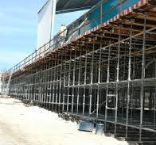
What is Falsework?
Falsework is that part of formwork which supports the forms.
Falsework is when dealing with situations where the supporting systems is carrying a vertical load.
Example of Bridge False-Work

Slide 16
What is Falsework?
Therefore, falsework can be defined as any temporary structure, in which the main load bearing elements are vertical, used to support a permanent structure and its associated members during the erection until it is self-supporting.
Example of Bridge False-Work

Slide 17
Purpose of Falsework
Temporary structure used to support formwork.
Falsework needs to be:
  Strong enough to carry its own weight, formwork, reinforcement, concrete, workmen and equipment
  Properly braced to prevent side-sway and buckling
  Supported on a firm surface, eg. concrete, or on stiff pads that spread the load on soft surfaces, eg. soil
  Easy and safe to erect and dismantle.

Slide 18
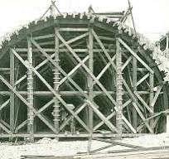
Types of Falsework
Three basic types of scaffold which can be employed in falsework are;
Scaffold tubes and fittings
Prefabricated systems
Specially designed falsework in the form of prefabricated units.

Slide 19
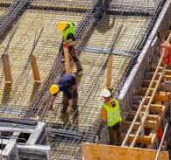
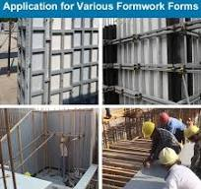
Materials for Formwork and Falsework
Steel
Timber
Plastic
PVC Plastic Formwork

Slide 20

Feedback
feedback

